Slide 2
Public Health and the Chinese Community
February 15, 2020
COVID-19
Robert M. Levin, MD
Health Officer

Slide 3
Coronavirus
Before 2003, 4 known to affect man
2003 SARS (bats, civet cats)
2012 MERS-CoV (camels)
December 28, 2019 COVID-19
Wuhan, Hubei Province

Slide 4
STREET VENDOR PREPARES A FROG FOR SALE IN A WUHAN STREET MARKET

Slide 5
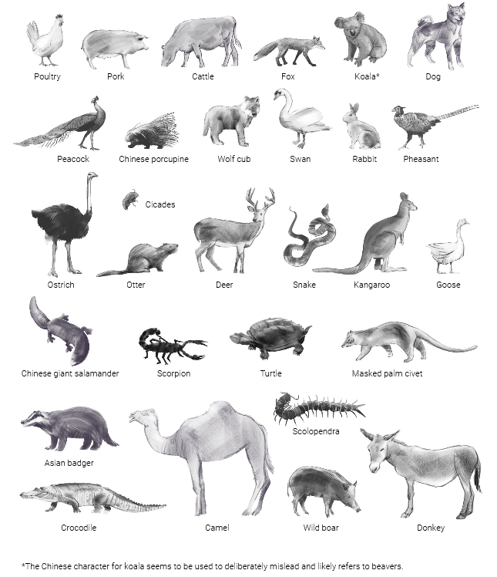
Meat advertised in wholesale market
Types of animal meat said to be available circulating online in China.

Slide 6
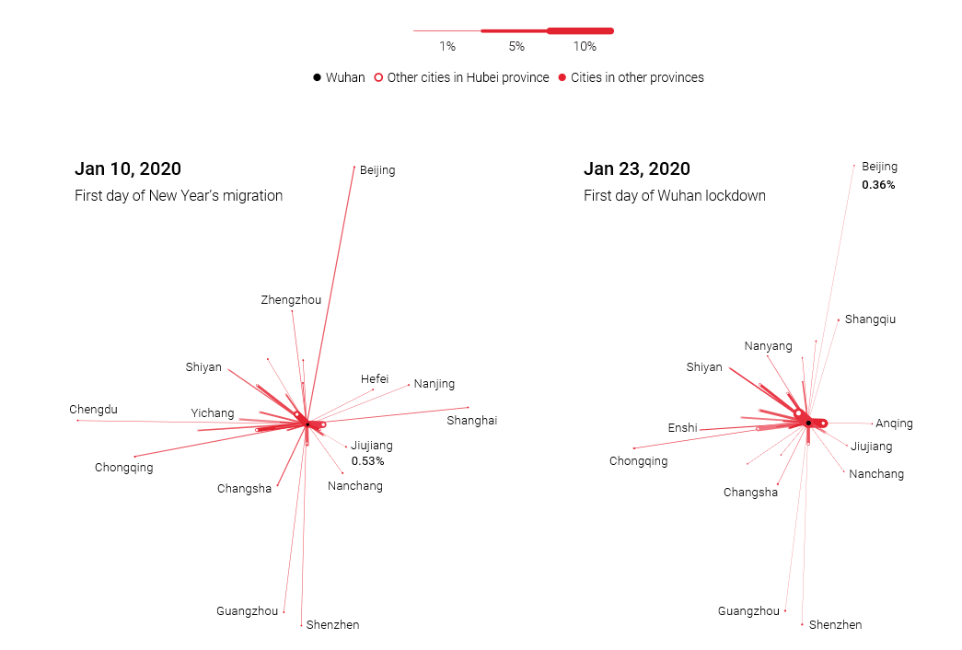
Where did 5 million Wuhaners go?
About five million residents left Wuhan before the city went into lockdown, revealed mayor Zhou Xianwang on January 26. Most headed to other cities in Hubei province according to Baidu, China’s popular search engine. Here we look at the top 30 destinations on two significant dates.

Slide 7
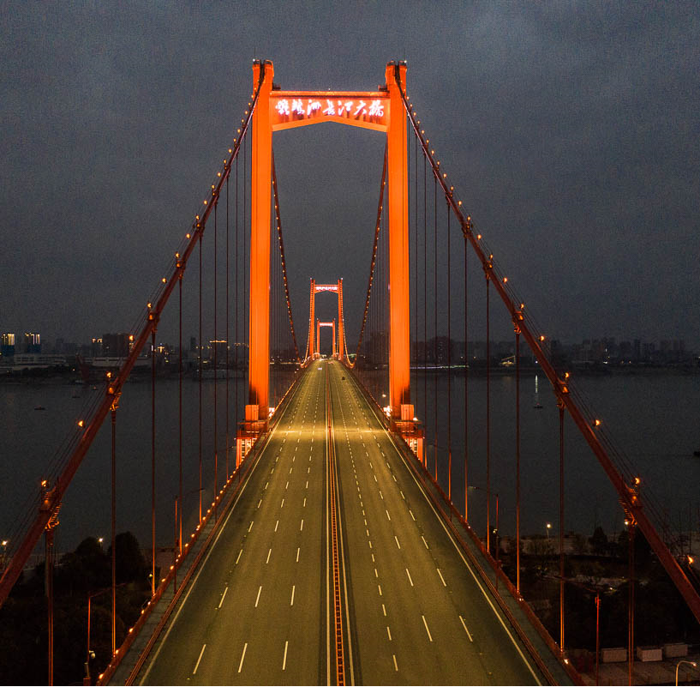
A Bridge Out of Wuhan

Slide 8
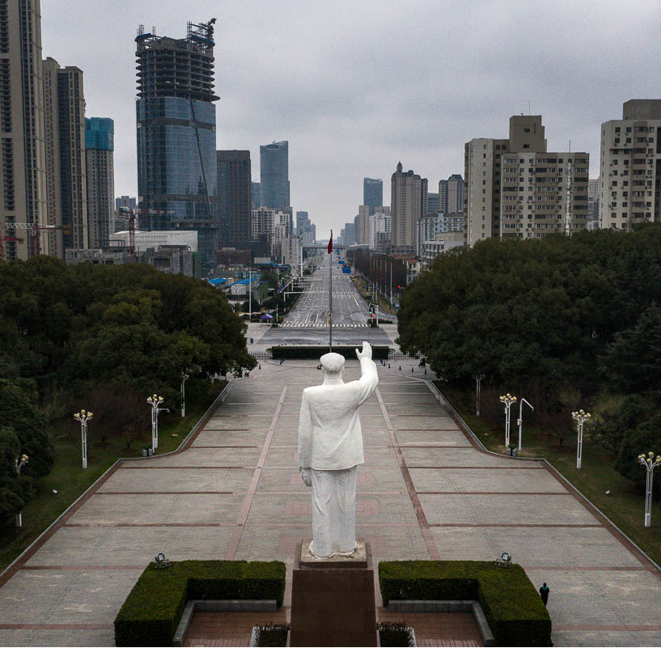
Wuhan

Slide 9
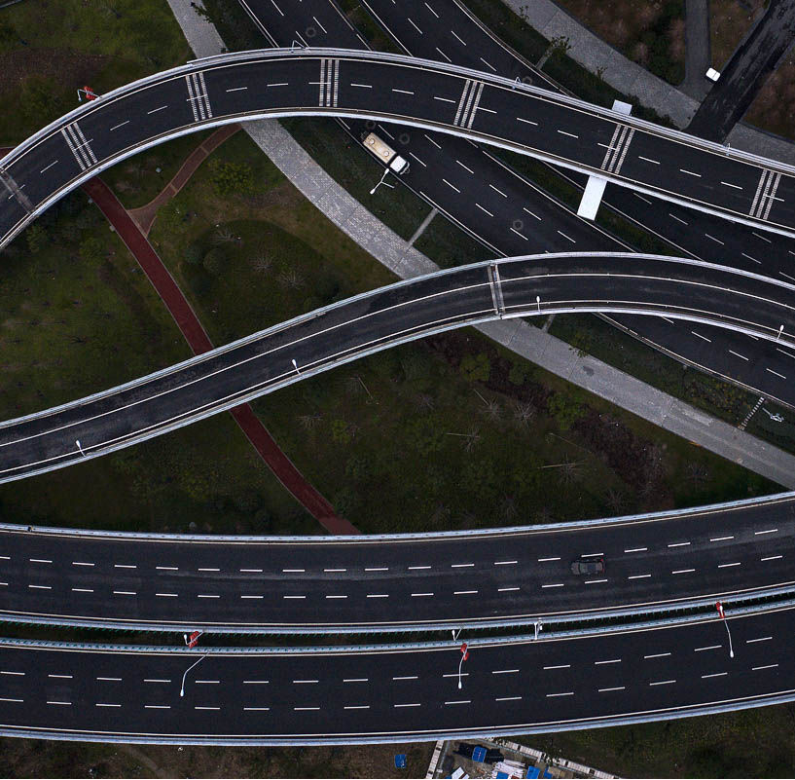
Wuhan Highways

Slide 10
Decontamination Before Entering a Building

Slide 11
Long lines throughout China
https://multimedia.scmp.com/infographics/news/china/article/3047038/wuhan-virus/index.html?src=article-launcher
(right click, open hyperlink)

Slide 12
Things We Want to Know About any Virus
How lethal is this virus?
How easily does it spread person-to-person?
How much immunity is in the population?
How well do we understand this virus?

Slide 13
COVID-19 as of this morning, February 15
China:
66,559 cases
1,524 deaths
Outside China:
545 cases
3 deaths (Japan, Philippines, France)

Slide 14
How lethal is this virus?
SARS: 15% mortality rate
MERS-CoV: 35% mortality rate
Influenza: 0.1% to 2.5% mortality rate
COVID-19:
2.3% mortality rate in China (2.0% to 2.5%)
0.5% mortality rate outside China (0.2-0.5%)

Slide 15
How easily does it spread person-to-person?
What is an R₀?
Measles: R₀ = 10 to 15
Pertussis: R₀ = 16 to 18 (aka whooping cough)
Polio: R₀ = 8 to 12
COVID-19: R₀ = 2.5 (1 to 3.5)

Slide 16
How much immunity is in the population?
Probably zilch, nada, gornisht, zero, 没有

Slide 17
How well do we understand this virus?
豆子

Slide 18
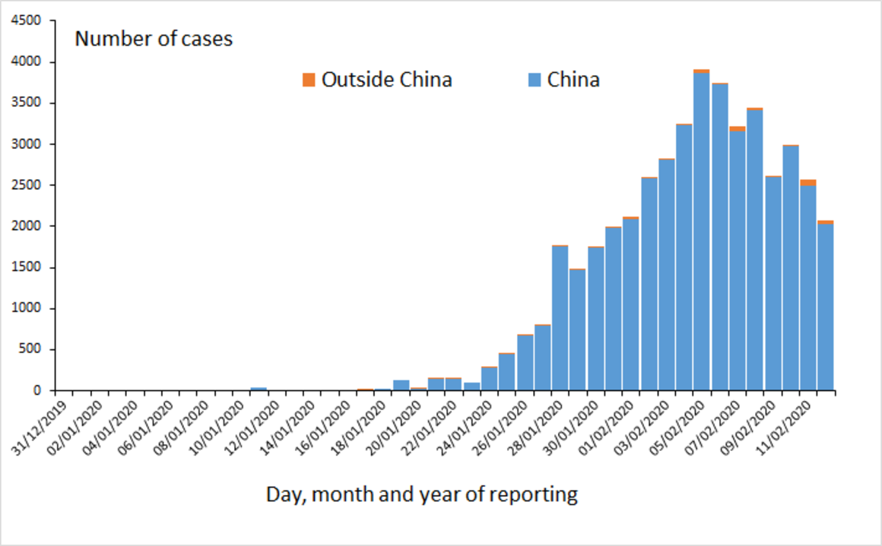
PRESENTATION TITLE (CAN BE UP TO 2 LINES)
December 31, 2015
Presentation Subtitle
Presenter’s Name

Slide 19
February 13 COVID-19

Slide 20
As of this morning, February 15

Slide 21
Distribution of laboratory confirmed cases of COVID-19 by continent (except China), as of 12 February 2020

Slide 22
Distribution of laboratory confirmed cases of COVID-19 by continent (except China), as of 13 February 2020

Slide 23
As of this morning, February 15

Slide 24
Geographic Distribution of COVID-19

Slide 25
Geographic distribution of COVID-19 cases worldwide, 15 February

Slide 26
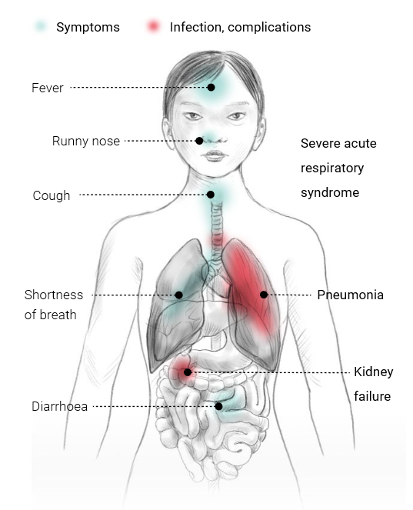
Symptoms and complications
Some infected people do not show any symptoms, while for others the symptoms can be severe, even fatal. Children under two years old and people aged over 65, or with weak immune systems are particularly susceptible to developing severe complications such as pneumonia.

Slide 27
Incubation Period

Slide 28
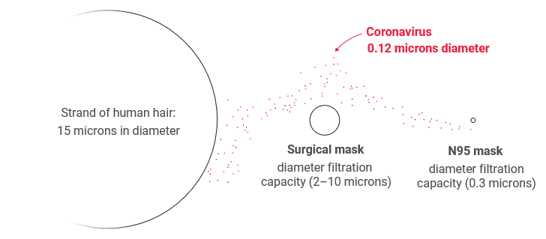
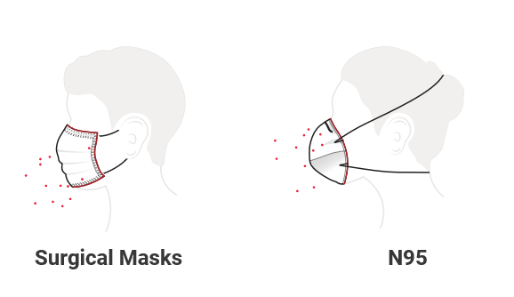
Masks
Usually the virus travels through droplets during sneezing or coughing. The vast majority of the droplets are less than 100 microns (0.1mm) across.

Slide 29
The United States
Quarantine vs. Isolation
15 cases in the United States
2 instances of person-to-person spread in the U.S.

Slide 30
Persons Under Investigation (PUI) in the United States
People under Investigation (PUI) in the United States
Positive 15
Negative 347
Pending§ 81
Total 443
4% of specimens tested are positive for COVID-19
Number of states and territories with PUI: 42

Slide 31
Chinese Health in America
Chinese Americans make up 1.2% of the total US population or 3.8 million individuals
California alone accounts for 40% of all Chinese Americans with 1.1 million individuals.
62% of Chinese immigrants in the US reported limited English proficiency.
34% of US-born Chinese speak some form of Chinese dialect at home.

Slide 32
Chinese Health in America
Chinese have higher rates of hypertension compared to other Asian American groups and Whites.
Chinese American women are less likely than many Asian American and Pacific Islander women to having a recent Pap smear or mammogram.
Less colon cancer screening is also seen among Chinese American men and women.
Cancer is the leading cause of death.
Heart disease is the second leading cause of mortality with a higher prevalence of hemorrhagic strokes and poorly controlled hypertension compared with Whites.

Slide 33
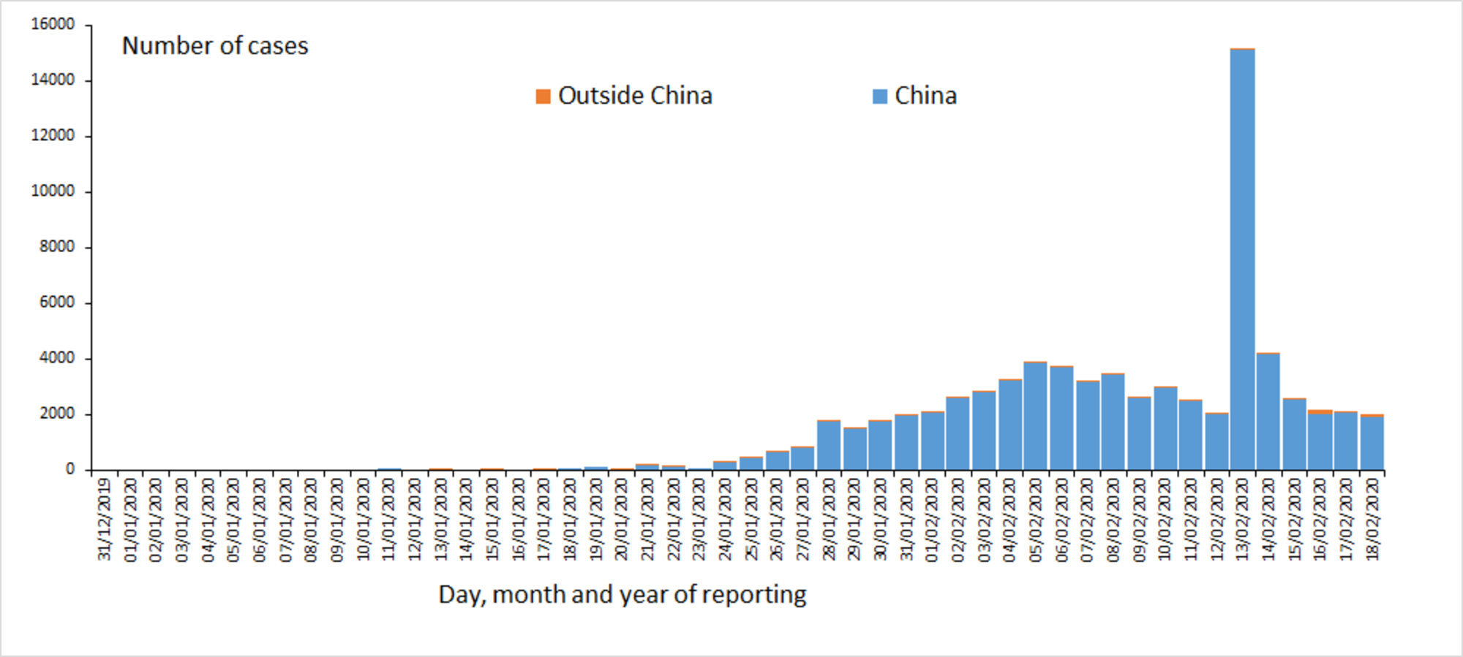
Update Tuesday, February 18, 2020
In China, 72,508 cases with 1,869 deaths = 2.6% mortality
Outside China, 820 cases with 4 deaths = 0.49% mortality

